Slide 1


Topic : SALES FORECASTING Domain : Machine Learning with Python
PANIMALAR ENGINEERING COLLEGE (An Autonomous Institution) Bangalore Trunk Road , Varadharajapuram Poonamallee , Chennai - 600 123
Department : Computer Science and Business System
TEAM MEMBERS :
Srikrishna.S -2021PECCB146
Srivarshan.J -2021PECCB147
Srivatsan.V -2021PECCB149

Slide 2
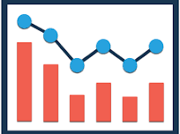
AGENDA
Objective
Abstract
Literature Survey
Existing System
Disadvantages
Proposed System
Advantages
System Requirements
Architecture Design
List of Modules

Slide 3
OBJECTIVE :-
Sales forecasting is the process of estimating future revenue by predicting how much of a product or service will sell in the next week, month, quarter, or year. At its simplest, a sales forecast is a projected measure of how a market will respond to a company's go-to-market efforts .
Sales forecasting is the process of estimating future sales for Revenue.This can be done using various methods, including historical sales data, market trends, and customer surveys. Sales forecasts are essential for businesses to ensure they have enough inventory to meet customer demand.

Slide 4

ABSTRACT :-
SalesProphet, a game-changing sales forecasting system at the forefront of innovation. Seamlessly merging artificial intelligence and predictive analytics, SalesProphet empowers businesses with unparalleled insights into future sales trends. By analyzing historical data, market dynamics, and customer behavior, this advanced system offers a crystal-clear vision of potential outcomes, enabling strategic decision-making and resource optimization .

Slide 5
LITERATURE SURVEY:-
TITLE OF THE PAPER | AUTHOR | VOLUME NUMBER | PUBLICATIONS | YEAR OF PUBLICATION
Sales Forecasting in Fashion Retailing: A Review | Lu, Y., Abhary, K., & Hossain, L. |  | International Journal of Production Economics | 2018
Sales Forecasting with High-Dimensional Data: A Study on the Apparel Industry | Li, X., Lee, L. H., & Zhao, X. |  | Decision Support Systems | 2016
Sales Forecasting Using Neural Networks | Armstrong, J. S., & Collopy, F. |  | International Journal of Forecasting | 2011
Time Series Forecasting with Neural Networks | Tenti, P., & Monfardini.C |  | International Journal of Forecasting, 1998. | 2008

Slide 6
EXISTING SYSTEM:-
Delphi Method : Suggestions of the Marketing Professionals and Opinions .
Sales Force Composite Method : The salesman who deals directly with customers can predict the sales more accurately .
Survey of Buyers Intensions : Purchasers of Product are asked about their requirements .
Historical Analogy Method : Predicting the sales using their Past sales history .

Slide 7
DISADVANTAGES :-
Inaccuracy
Lack of Sales History
Change in customer Behaviour
Clean data
Not Accountable to Market change

Slide 8

PROPOSED SYSTEM :-
As we are doing this prediction using machine learning it helps sales forecasting by using algorithms to analyze historical sales data and make predictions about future sales. It uses time-series analysis, regression analysis, and decision trees to generate more accurate forecasts based on multiple factors .

Slide 9
ADVANTAGES :-
Get insights into upcoming sales and revenue .
Accuracy is Increased .
Attract stakeholders and make appeal .
Implementation is easy .
More accurate compared to the traditional
Forecasting .

Slide 10
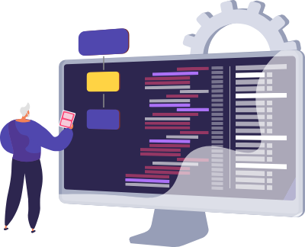
Software Requirements :
Jupyter notebook
github
Python 3
Hardware Requirements :
Memory Space
Install Windows

Slide 11
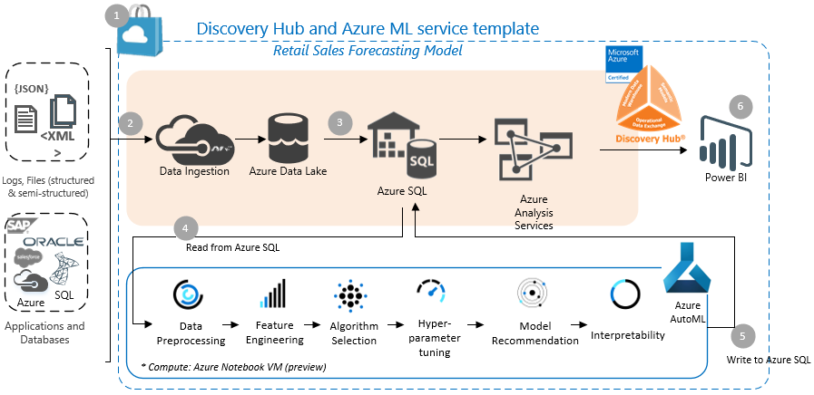
ARCHITECUTURE DIAGRAM:-

Slide 12
MODULES :-
Data Collection
Data Cleaning and Preprocessing
Algorithm Selection
Model Evaluation
Deployment

Slide 13
Data Collection:
Historical Sales Data: Gather data on past sales, including product-wise and region-wise sales, seasonality, and any external factors that may have influenced sales.
External Data: Incorporate relevant external data such as economic indicators, market trends, and social events that could impact sales.
Data Cleaning and Preprocessing:
Cleanse the data to remove outliers, missing values, and errors.
Normalize and scale data to ensure consistency and improve model performance.
Convert categorical variables into numerical representations using techniques like one-hot encoding.

Slide 14
ALGORITHM SELECTION:-
Choose appropriate forecasting algorithms based on the characteristics of your data. Common algorithms include: Autoregressive Integrated Moving Average (ARIMA)
Exponential Smoothing State Space Models (ETS)
Prophet
Machine Learning models (e.g., Random Forest, Gradient Boosting, LSTM for deep learning)
One of the most common methods used to predict sales is regression analysis. This method involves using historical sales data to train a model that can predict future sales. The model can take into account factors such as past sales, marketing campaigns, and economic indicators to make its predictions.

Slide 15
Model Evaluation:
Use metrics such as Mean Absolute Error (MAE), Mean Squared Error (MSE), or Root Mean Squared Error (RMSE) to evaluate the model's accuracy.
Implement backtesting to assess the model's performance on historical data.
Deployement:
Deploy the model in a scalable and maintainable environment, considering factors like containerization or serverless architectures.

Slide 16
REFERENCES:-
"Sales Forecasting in Fashion Retailing: A Review"
Authors: Lu, Y., Abhary, K., & Hossain, L.
Published in: International Journal of Production Economics, 2018.
Link: ScienceDirect
"Sales Forecasting with High-Dimensional Data: A Study on the Apparel Industry"
Authors: Li, X., Lee, L. H., & Zhao, X.
Published in: Decision Support Systems, 2016.
Link: ScienceDirect
"Sales Forecasting Using Neural Networks"
Authors: Armstrong, J. S., & Collopy, F.
Published in: International Journal of Forecasting, 1992.
Link: ScienceDirect
"Time Series Forecasting with Neural Networks: An Empirical Study Using the Bank of Canada's Quarterly Projection Model"
Authors: Tenti, P., & Monfardini, C.
Published in: International Journal of Forecasting, 1998.
Link: ScienceDirect

Slide 17
CONCLUSION :-
In conclusion, sales forecasting plays a crucial role in the success of any business. It offers several advantages that can guide decision-making, enhance operational efficiency, and maximize profitability.
By predicting future sales, businesses can identify potential gaps in demand and adjust their production and supply chain accordingly.

Slide 18
Thank you

